Slide 1
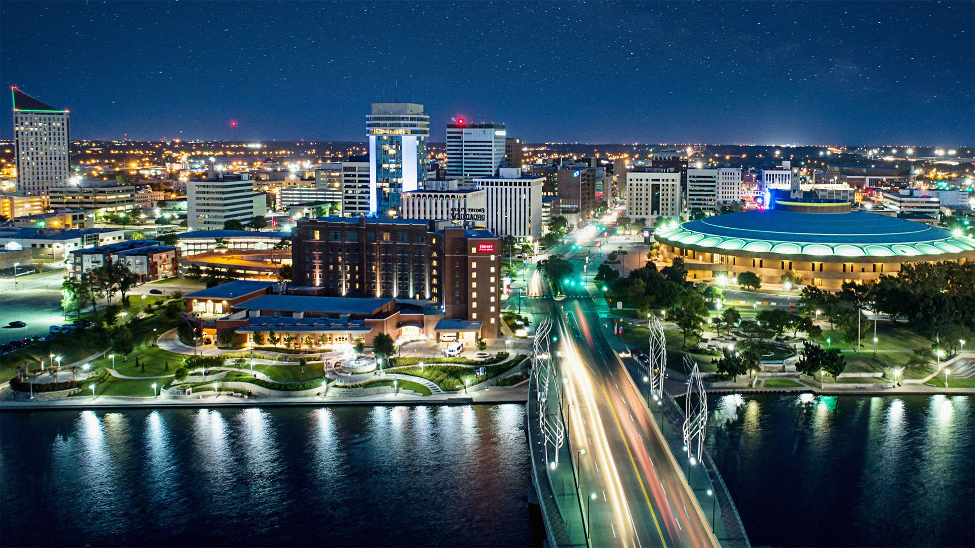
NACCC Treasurer's Report & Budget Presentation

Slide 2
There is a budget narrative that accompanied this report. We recommend that you print it out and refer to it during the presentation.

Slide 22
Investor Worries!
Participants in the CIT are not immune to the downturns that investments experience from time to time. What the CIT brings to the table during these times is a dedicated team of professionals from Vanguard plus the oversight of dedicated and knowledgeable volunteers from multiple NACCC churches. These groups continue to forecast future results, adjusting the portfolio, when necessary, but never losing sight of the long-term investment objectives of the Trust.

Slide 23
SPECIAL WELCOME TO THOSE CHURCHES WHO JOINED THE CONGREGATIONAL INVESTMENT TRUST IN FY 2021-2022!

Slide 24
Congregational Church of East Sumner, ME
Pine Hill Congregational Church, MI
(Information about the CIT can be found at www.naccc.org .)

Slide 25
